Slide 1
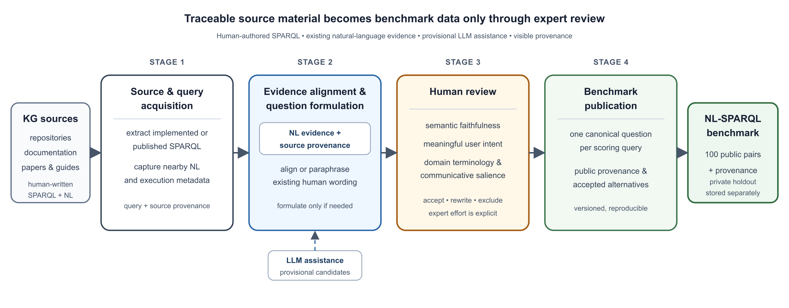
Musparql
WORKSHOP FOCUS
Human review turns provisional wording into benchmark data
Notes:
Source figure: docs/papers/scik-2026/scik-2026-musparql-workflow.svg and its paper-rendered PNG. Paper title used in the MTSR manuscript: ‘Provenance-Aware Curation of NL-SPARQL Evaluation Data for Domain Knowledge Graphs’, Polina Proutskova, 2026. Figure caption: The four-stage Musparql workflow. Human-authored SPARQL is collected with source provenance; existing natural-language evidence is aligned before new wording is formulated; expert review determines semantic and communicative adequacy; and publication separates compact scoring pairs from richer provenance. LLM assistance is confined to Stage 2 and cannot publish a benchmark item without Stage 3.

Slide 2
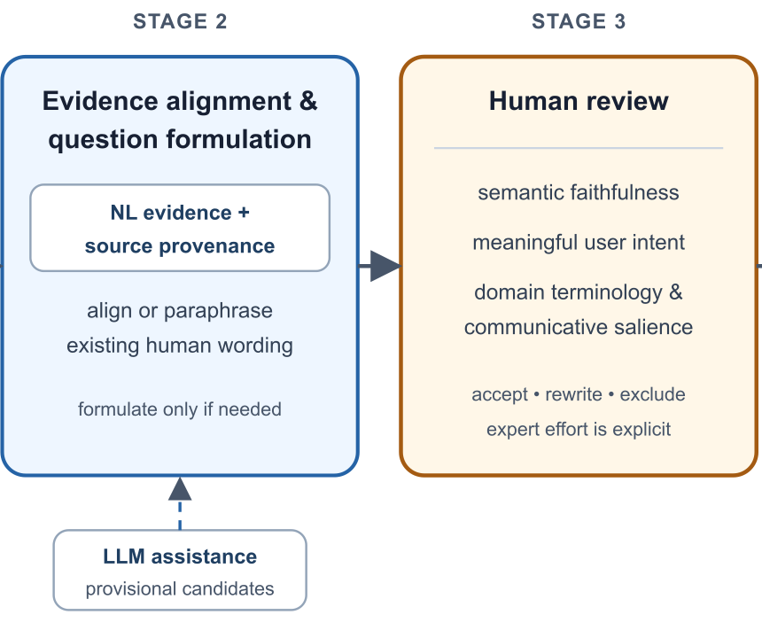
Musparql
The review gate
Today we work at Stage 3
Check whether the question matches the SPARQL
Correct terminology and missing meaning
Accept, rewrite or exclude the candidate
Next: live workshop pipeline
Notes:
This slide enlarges Stages 2 and 3 from Figure 1 to introduce the live workshop demonstration. The three review prompts summarize the paper’s Human Review section.

